Slide 1
2020
Design Pattern Sharing
Reporter：Tian Jihui Time：2020.11.03

Slide 2
Content
Concept
User Case
Discussion
01
02
03

Slide 3



Thinking Method
01
Bottom Thinking
Abstract Thinking
Language Conversion
Compiler Conversion
Memory Model
Runtime Mechanism
Object Oriented
Component Encapsulation
Design Pattern
Architecture Pattern
Decompose
Abstract
Notes:
思维方式：
底层思维：向下，如何把握机器底层从微观理解对象构造
语言转换，编译转换，内存模型，运行时机制
抽象思维：向上，如何将周围的世界抽象为程序代码
面向对象，组件封装，设计模式，架构模式
分解VS抽象

Slide 4
Design Principles
01
Single Responsibility Principle
Open Closed Principle
Liskov Substitution Principle
Interface Segregation Principle
Dependence Inversion Principle
Object Combination (Black Box) VS Class Inheritance (White Box)
Target Interface VS Target Implementation
Encapsulate Change Points
Notes:
设计原则：
Single Responsibility Principle：单一职责原则
Open Closed Principle：开闭原则
Liskov Substitution Principle：里氏替换原则
Interface Segregation Principle：接口隔离原则
Dependence Inversion Principle：依赖倒置原则
对象组合VS类继承，封装变化点，针对接口VS针对实现

Slide 5
Refactoring Techniques
01
Static -> Dynamic
Early binding -> Late binding
Inheritance -> Composition
Compile-time dependency -> Runtime dependency
Tight coupling -> Loose coupling
Iterative Design
Notes:
重构技法：迭代设计
静态->动态，早绑定->晚绑定，继承->组合，编译时依赖->运行时依赖，紧耦合->松耦合

Slide 6
Design Pattern
01
Component collaboration:
Template Method, Strategy, Observer
Single responsibility: Decorator, Bridge
Object creation:
Factory Method, Abstract Factory, Prototype, Builder
Object performance: Singleton, Flyweight
Interface isolation: Facade, Proxy, Mediator, Adapter
State changes: Memento, State
Data structure:
Composite, Iterator, Chain of Responsibility
Behavior changes: Command, Visitor
Domain issues: Interpreter
Creation
Structure
Behavior
Notes:
模式分类：
创建型，结构型，行为型
封装变化角度：
组件协作，Template Method, Strategy, Observer
单一职责，Decorator, Bridge
对象创建，Factory Method, Abstract Factory, Prototype, Builder
对象性能，Singleton, Flyweight
接口隔离，Facade, Proxy, Mediator, Adapter
状态变化，Memento, State
数据结构，Composite, Iterator, Chain of Responsibility
行为变化，Command, Visitor
领域问题，Interpreter

Slide 7
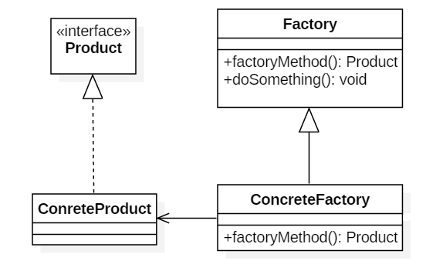
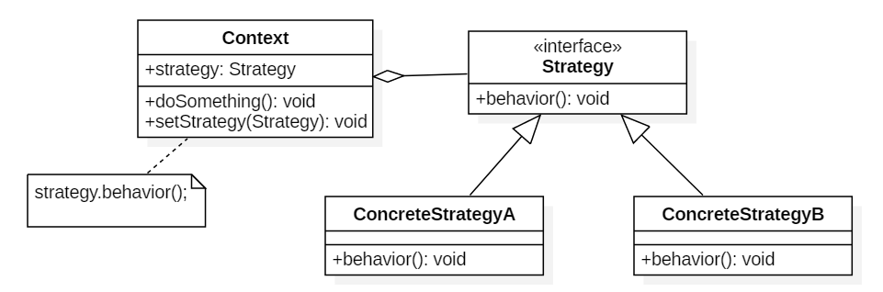
User Case: Strategy + Factory
02
Notes:
Strategy+Factory

Slide 8
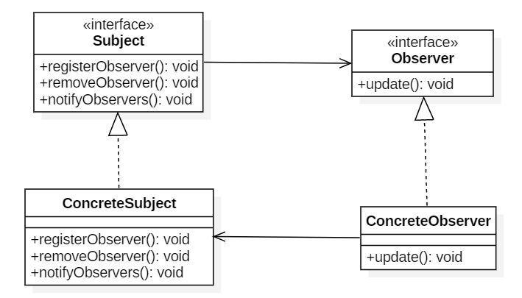
User Case: Observer
02
Notes:
Observer

Slide 9
Object model
02
class A : B{ //... }; | class A { B b; //... }; | class A { B* pb; //... }
B
A
B
A
B
A
Notes:
对象模型：class A { B* pb; //... };

Slide 10
Use With Caution
03
When:
the code is poorly readable
the requirements are shallow
the changes have not appeared
the system is not a key dependency
the project has no reuse value or will be released
Notes:
审慎使用模式：
when 代码可读性差，需求理解浅，变化没有显现，非系统关键依赖点，项目无复用价值或将要发布

Slide 11
03
Any Question ?
.
.
.

